Slide 1
Auto Insurance
OPIM 5603 Statistics in Business Analytics
R - Omatics
Juhi Maheshwari , Malgorzata Pozniak
Kumud Ranjan, Charles Steiz, Ruying Xia

Slide 2

Problem Statement
The average time of accidents happening over years is rapidly increasing followed by number of claims made by an individual. The main goal of our analysis was to measure how each factor in the data set affects Car Crash and Claims Frequency to determine how risky the prospective client is for the company. Based on our study, insurance company can calculate how likely the individual is going to get into accident and what rate the vehicle should be insured under.
“If the cost of claims continues to rise, rate increases are inevitable..”
James Lynch, chief actuary for the Insurance Information Institute

Slide 3
Introduction
What factors are significant to determine if the prospective customer is risky or not for the insurance company?
What factors are significant to determine how likely the car is going to be in an accident?
Do income and education have any impact on MVR points?
Are red cars more likely to get into accident?
Are longer distance travelers more likely to get into accidents?
Are single or married individuals more responsible drivers?
Is the age significant factor to determine the risk for the insurance company?
Is the car type significant to determine how responsible the driver is?
Do car value have any impact on accident frequency?
Are older cars more likely to get into accident?

Slide 4
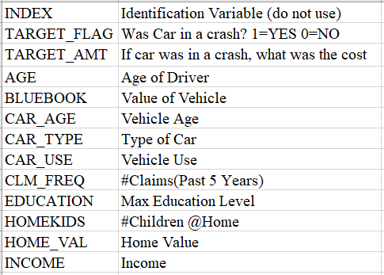
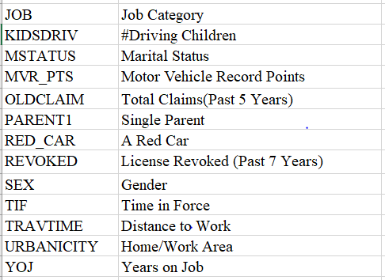
The Dataset

Slide 5
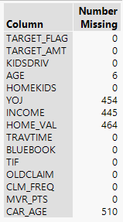
Data Preprocessing
Missing Values:
6 columns had missing values:
Categorical: Job
Continuous: Home_val, Income, Car_age, YOJ, Age
Missing Job values were computed to ‘unknown’
Age had 6 missing values; No trends found hence deleted
YOJ, Income, Home_val and Car_age had 454, 445, 464 and 510 missing values. Rather than putting in mean/median value, we decided to impute these values looking at different implied models/trends the dataset depicted.

Slide 6
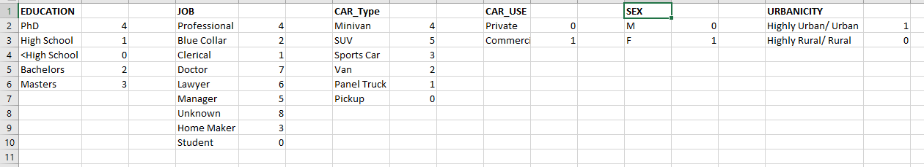
Data Preprocessing
Variable Transformation:
For the all columns with categorical values, their values were coded to the numerical values to make the modeling significantly relevant and easier. Below are the codes added for values of each categorical columns. All the column values with yes/no values were coded to 0 and 1 respectively, where ‘0’ being No and ‘1’ depicting Yes.

Slide 7
Themes in the dataset
Physical
Personal Life
Career
Assets
Policy

Slide 8
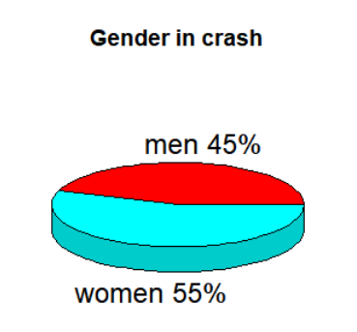
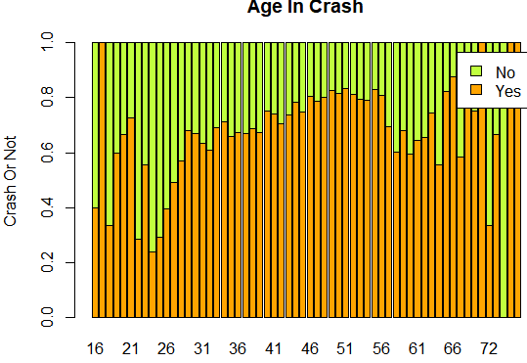
Data Visualization - Physical

Slide 9
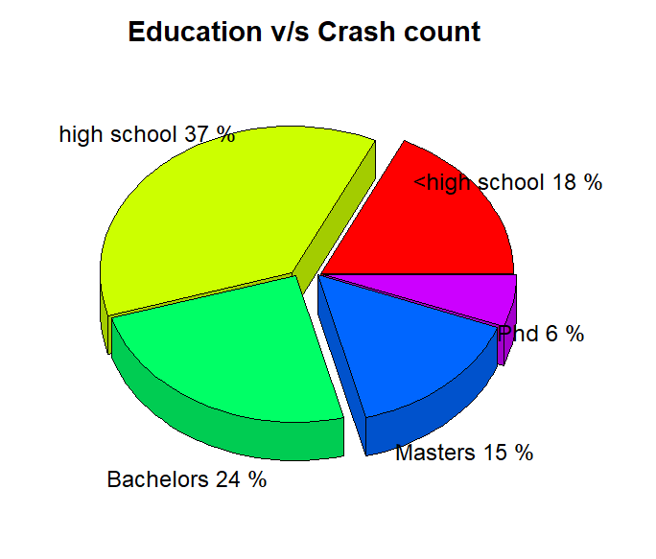
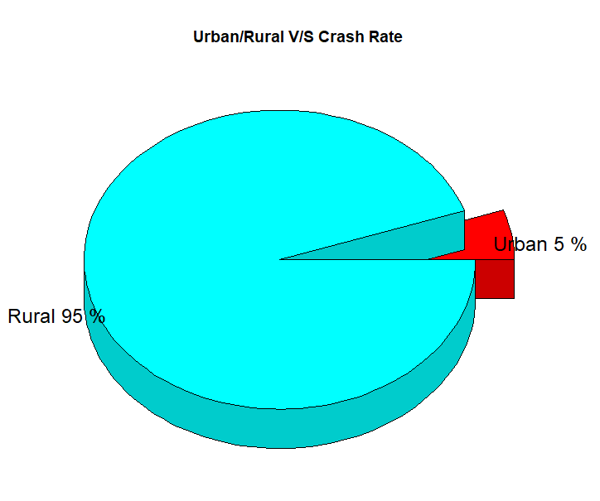
Data Visualization - Personal

Slide 10
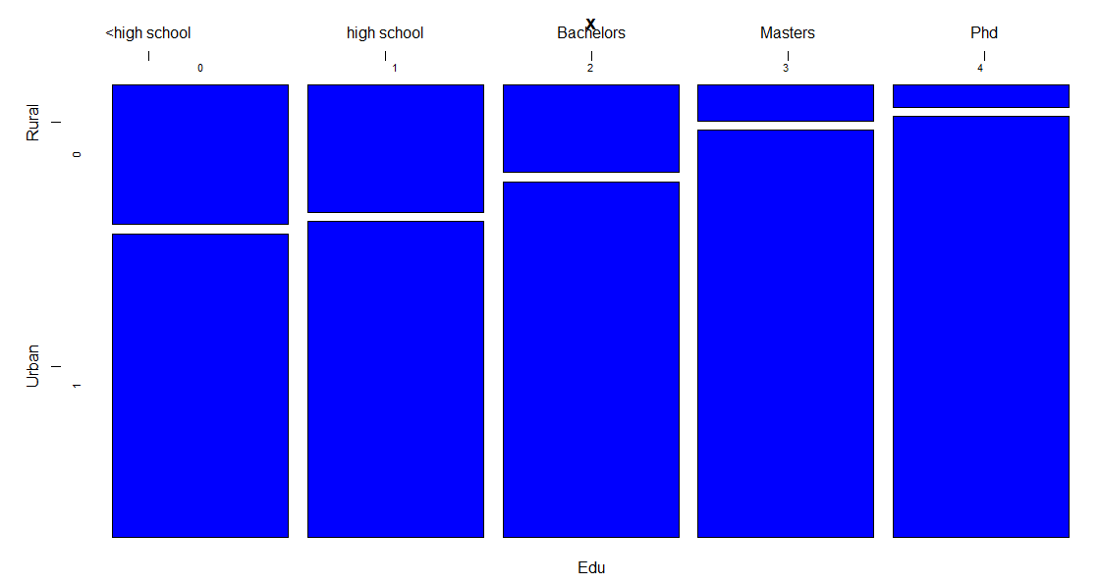
Data Visualization - Personal

Slide 11
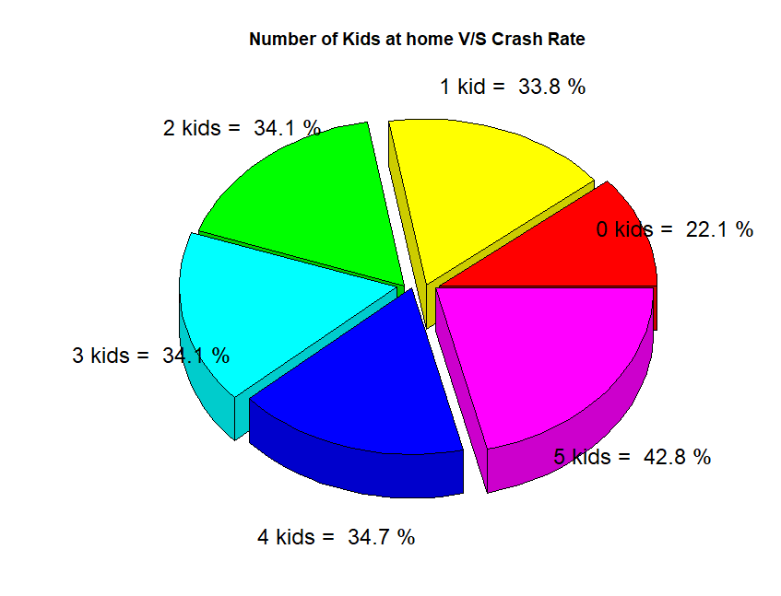
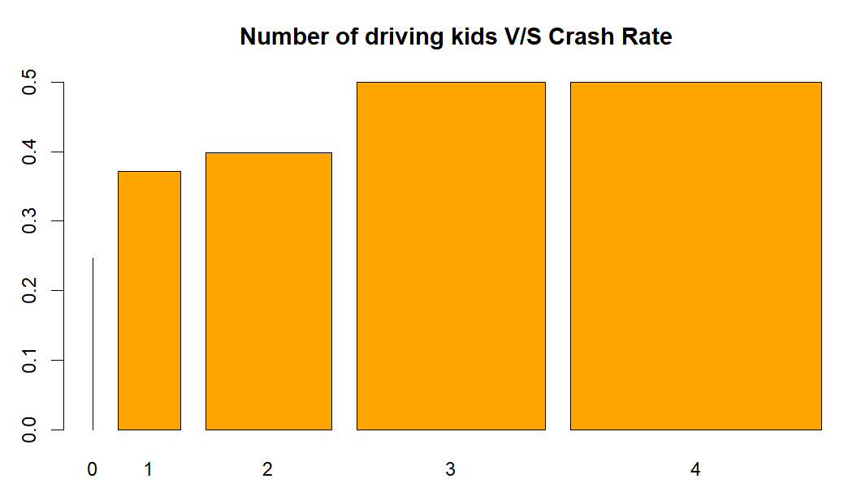
Data Visualization - Personal

Slide 12
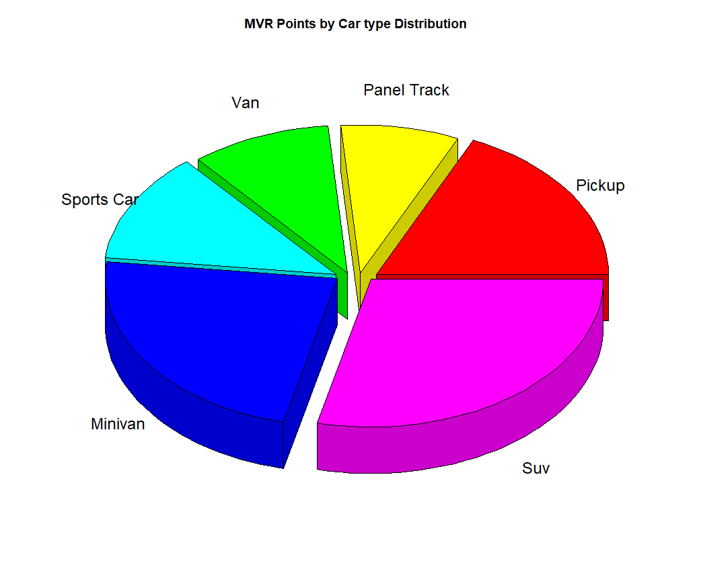
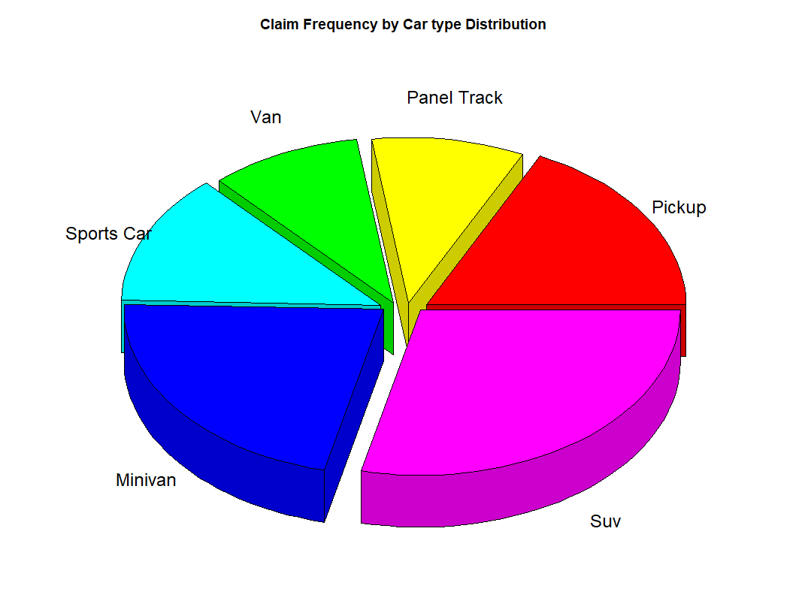
Data Visualization - Assets

Slide 13
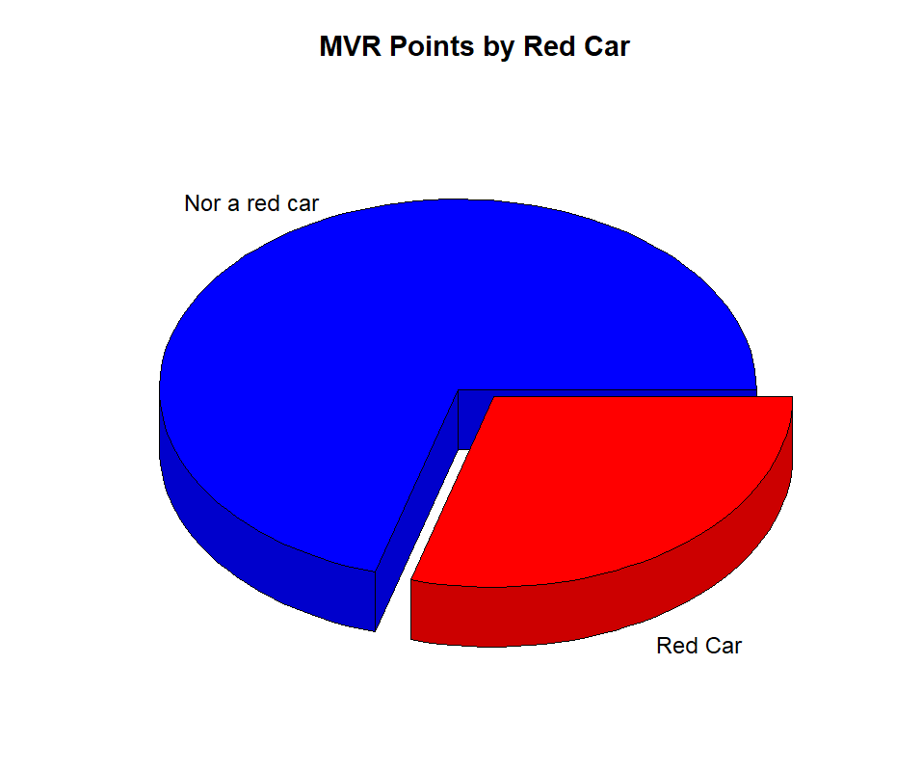
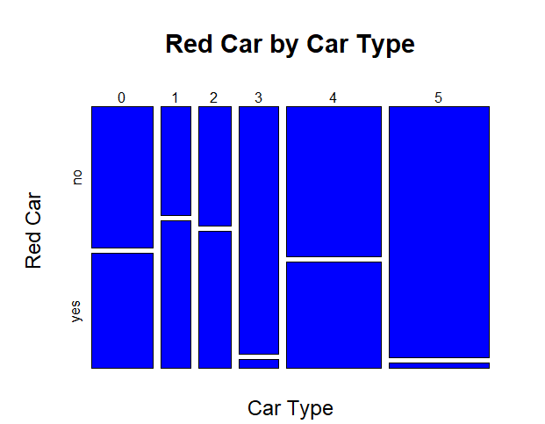
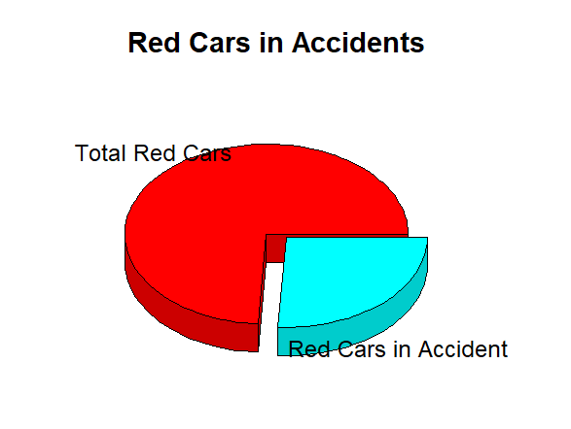
Data Visualization - Assets

Slide 14
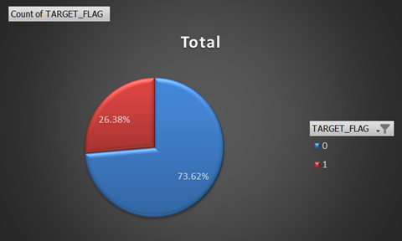
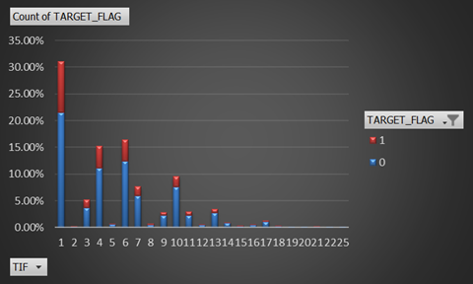
Data Visualization - Risks

Slide 15
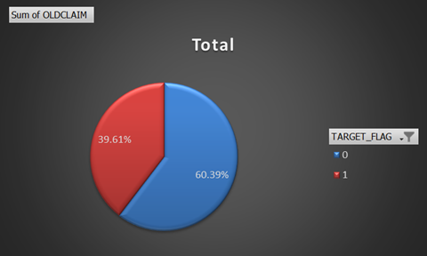
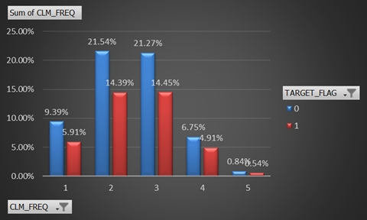
Data Visualization - Risks

Slide 16
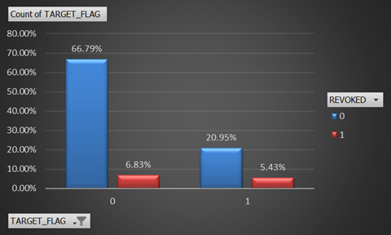
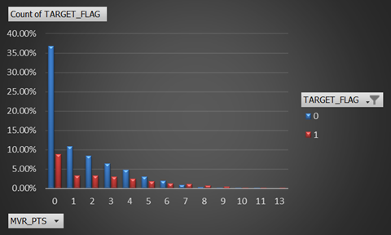
Data Visualization - Risks

Slide 17
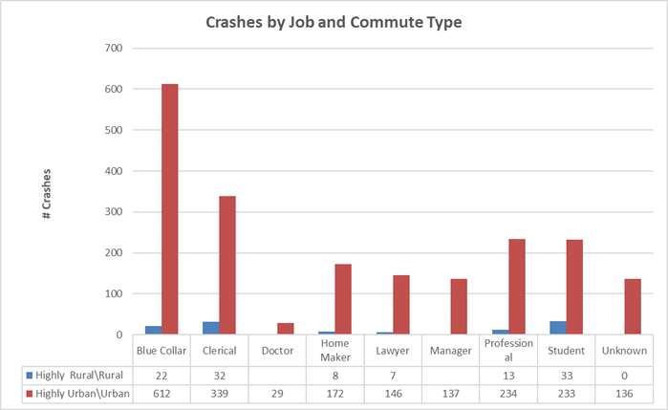
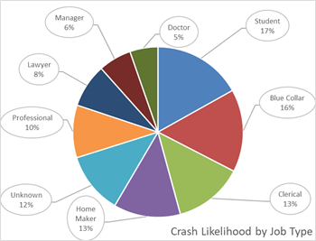
Data Visualization - Career

Slide 18
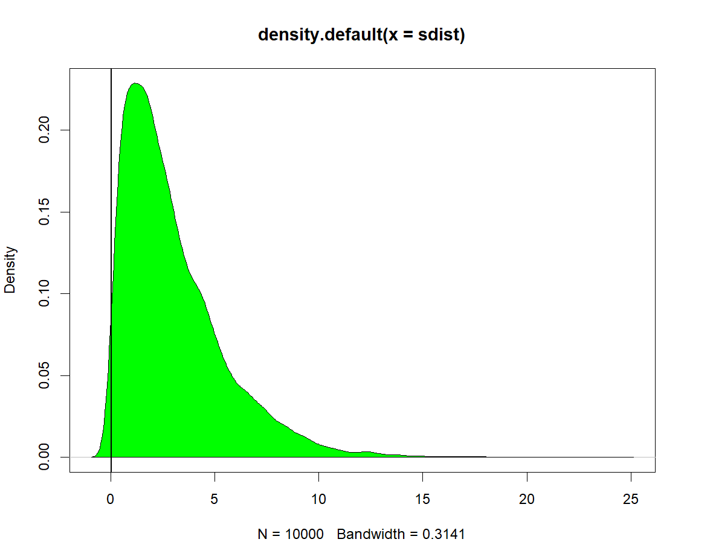
Will I get into an accident if I drive a Red Car?
Hypothesis: Red car has no impact on getting into a crash
Target Flag vs Red Car
Statistical Method: Two Sample Test
P-value = 0.9988
Conclusion: High pvalue indicates that we fail to reject the null hypothesis. Having a red car has no impact on crash.

Slide 19
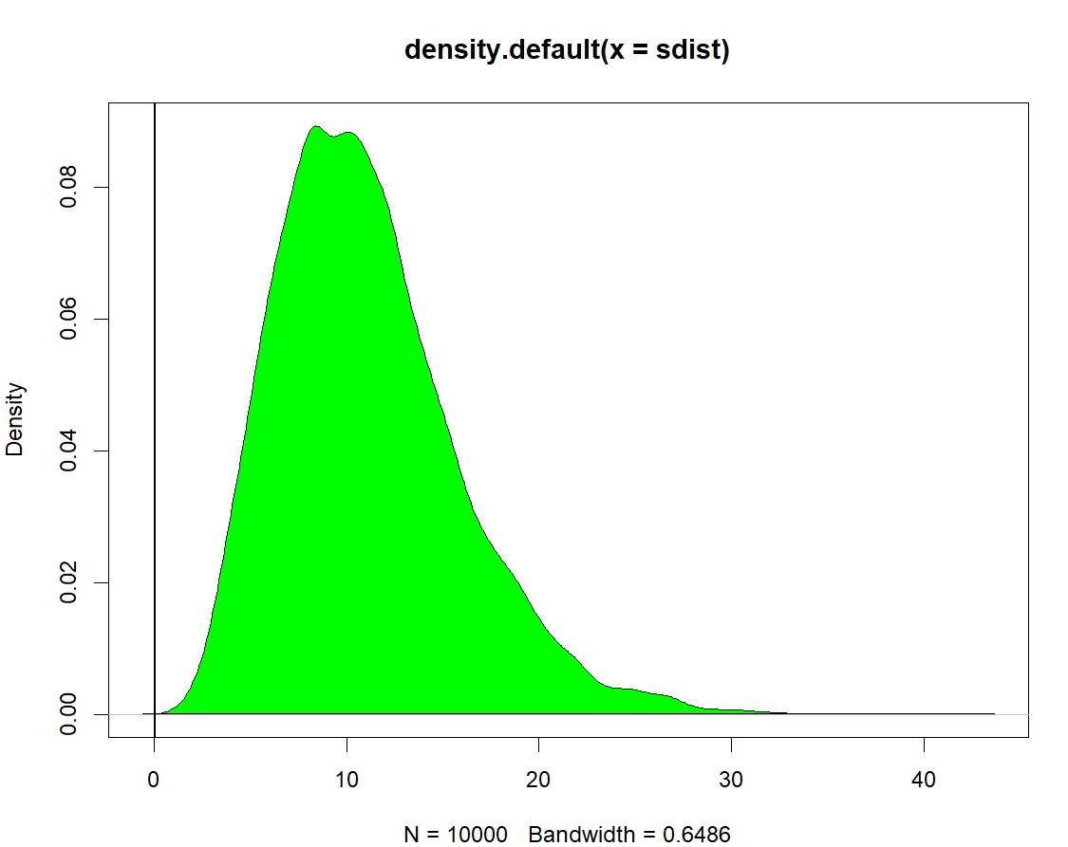
Will car type play significant role on a possible crash?
Hypothesis: Car type has an impact on crash potential.
Target Flag vs Car Type
Statistical Method: Two Sample test
P-value = 1
Conclusion: High pvalue indicates that we fail to reject null hypothesis. Car type has impact on accidents frequency.

Slide 20
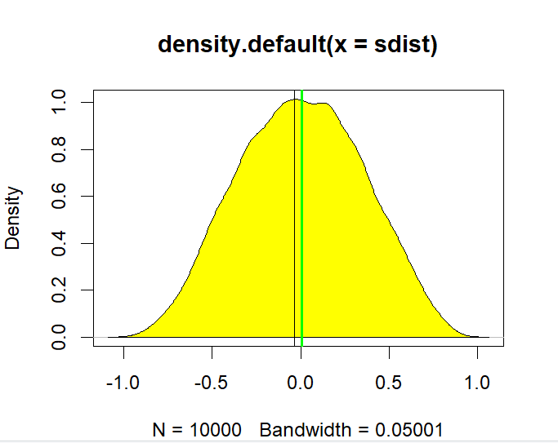
Will having an expensive car decrease my claim frequency?
Hypothesis: Car value have an impact on claim frequency
Claim Frequency vs Bluebook Value
P-value = 0.9175
Tstat = -0.036
Conclusion: Low pvalue indicates we fail to reject null hypothesis. Car values has an impact on claim frequency.

Slide 21
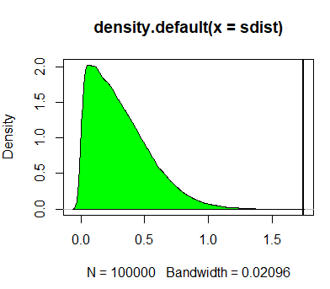
Are long distance travellers more in risk to crash ?
Hypothesis: The distance to work plays no role in cars getting into a crash
Pvalue = 0
Tstat = 1.745
Conclusion: Low pvalue indicates to reject null hypothesis. People who drive longer tend to get into crashes more often than others who have shorter travel time.

Slide 22
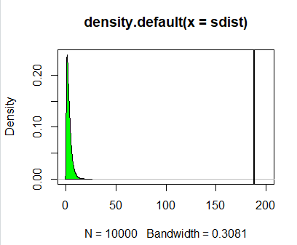
Are licence revoked and involvement into crash independent events?
Hypothesis: License Revoked in the Past 7 Years and Involvement in crash are independent.
P-value = 0
Tstat = 188.4
Conclusion: Low pvalue indicates to reject null hypothesis. A driver involved in a crash is more likely to have had driver’s license revoked in the past.

Slide 23
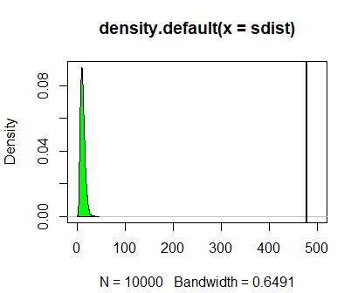
If I crashed once, am I at bigger risk of getting into accident again ?
Hypothesis: Claim frequency in past and involvement in crash are not dependent.
P-value = 0
Tstat = 478
Conclusion: Low p-value indicates to reject null hypothesis. Since p value is 0, we reject null hypo. We can conclude that having claimed once increases chances to crash again.

Slide 24
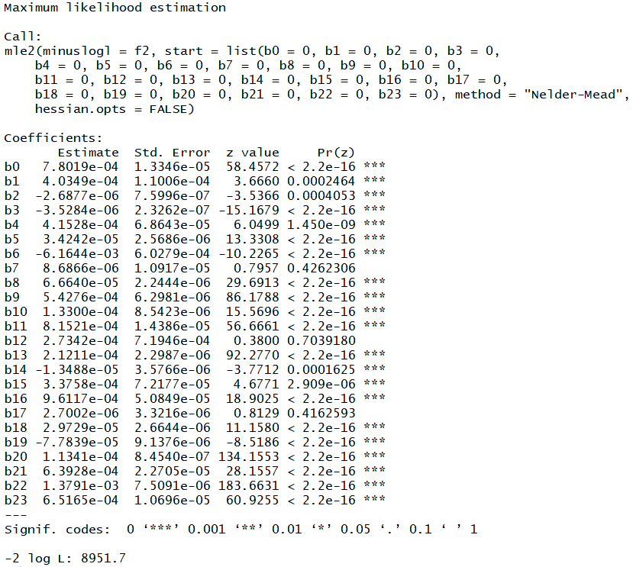
Maximum Likelihood (TARGET_FLAG)
AIC: 8951.7
HOMEKIDS, RED_CAR and TRAVTIME are not significant.

Slide 25
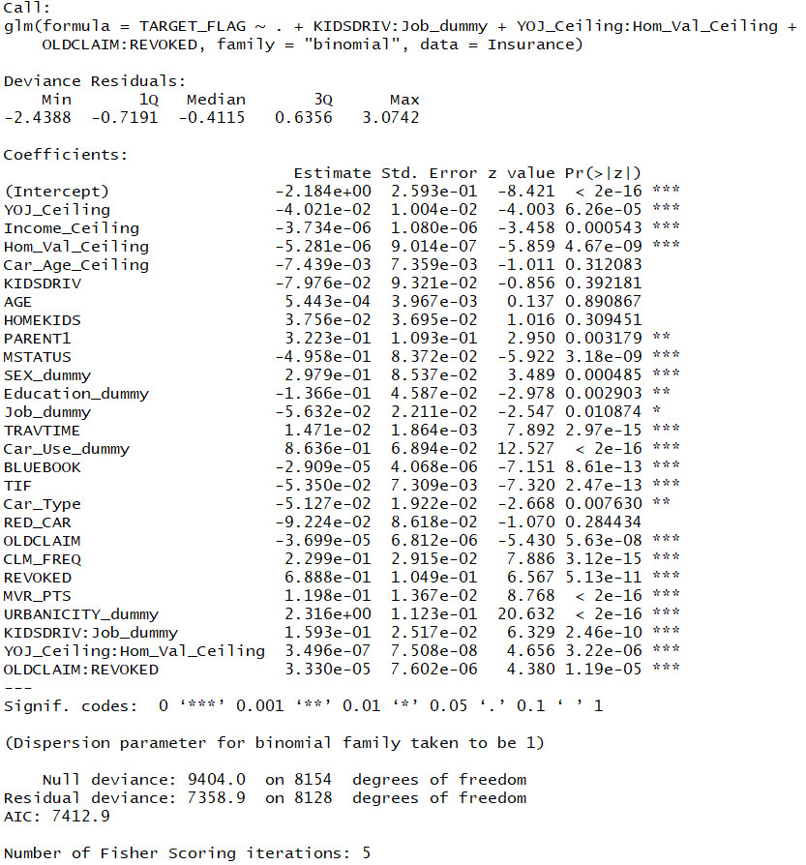
Logistic Regression - Interaction Terms
AIC: 7412.9
KIDSDRIV: Job_dummy
YOJ_Ceiling: Hom_Val_Ceiling
OLDCLAIM: REVOKED

Slide 26
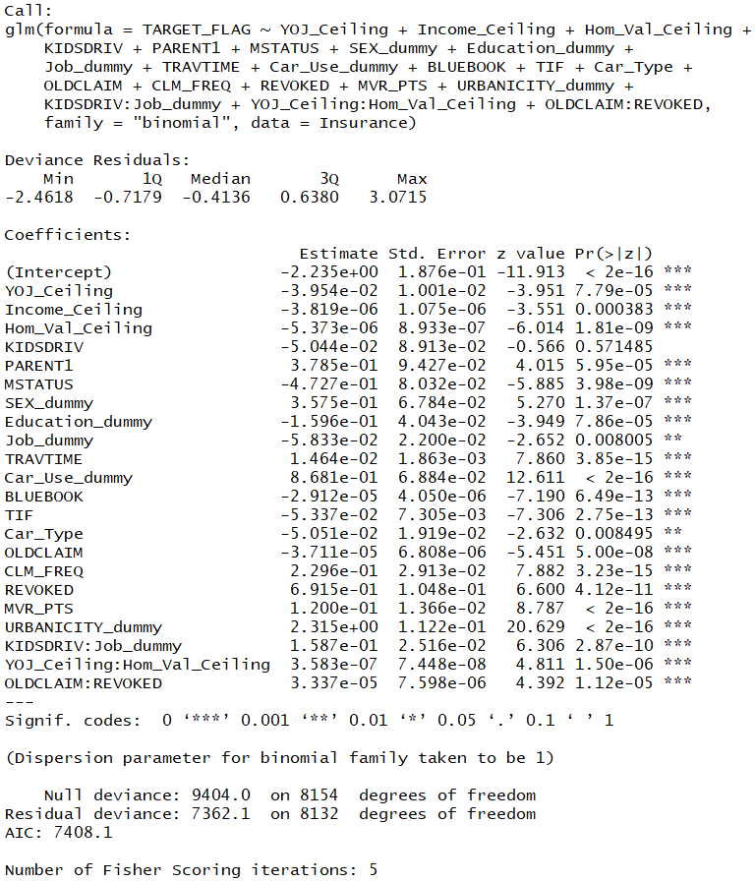
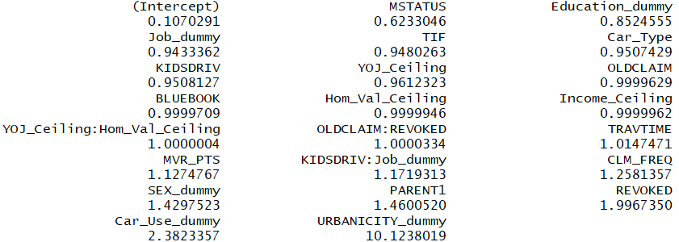

Logistic Regression - Using step Function
-
AIC of final model : 7408.1
Overall accuracy = 79.06%
Precision = 66.62%
AGE
Car_Age_Ceiling
HOMEKIDS
RED_CAR

Slide 27
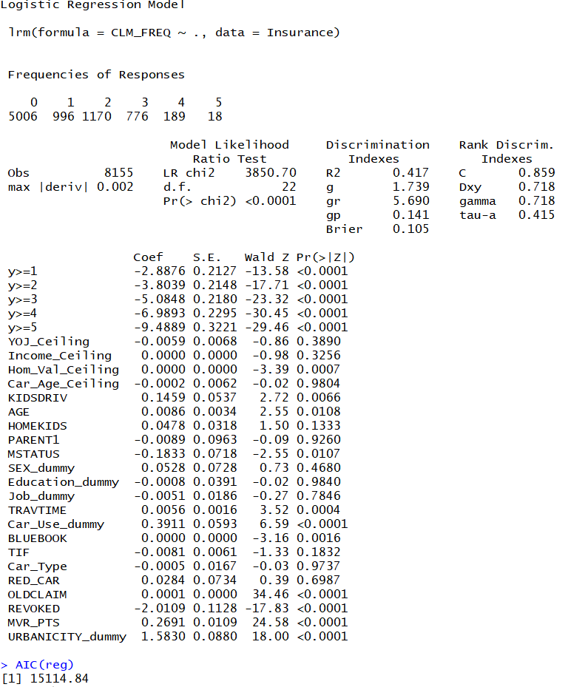
Ordinal Logistic Regression (CLM_FREQ)
AIC: 15114.84
CLM_FREQ has values ranging from 1 to 5 which indicates some kind of order. Hence Ordinal Logistic Regression was run

Slide 28
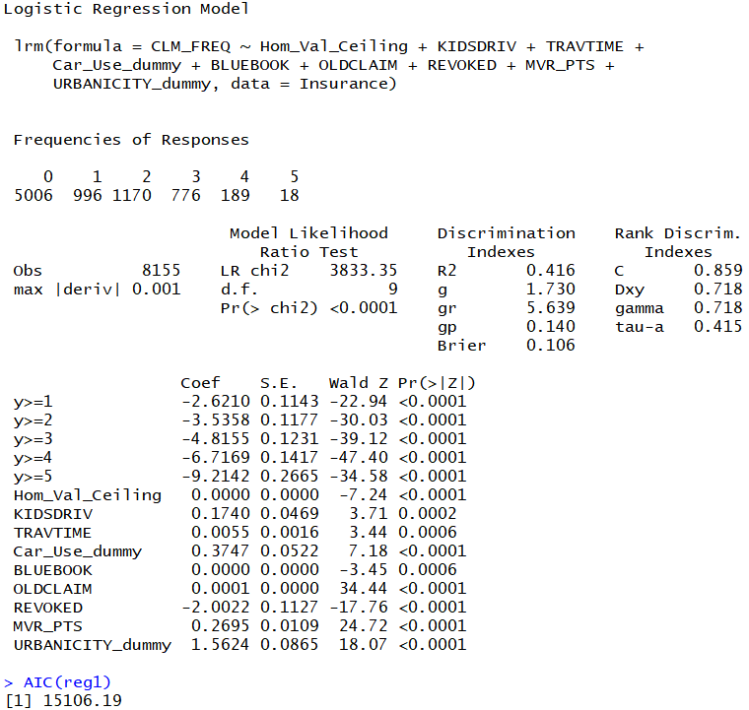
Ordinal Logistic Regression - Using fastbw()
9 predictors
AIC of final model : 15106.19
Most significant: REVOKED and URBANICITY_dummy

Slide 29
Conclusion
R-Omatics performed statistical testing and observed patterns for independent variables and assessed their impact on:
Occurrence of accidents
Frequency of claims
We established that certain “common knowledge” about auto insurance did not hold up to statistical analysis. Example: Our analysis supported the hypothesis that drivers of red cars are not at greater risk of a crash. We also dispelled the myth that Females prefer more red cars over male drivers.
The riskiest customers in terms of age is difficult to derive. Drivers with high school and undergraduate degrees show the greatest tendency for accidents, possibly in line with the distribution of this education in the population.

Slide 30
Conclusion
Drivers with a history of moving vehicle violations (license points and revoked licenses) also demonstrated a tendency to crash. People with four categories of professions demonstrated the greatest chance of crashes: blue collar workers, clerical workers, students and professionals.
We found that drivers with SUVs, pickups and minivans had both the greatest chances of receiving points from moving vehicle violations and filing claims over the last five years.
We tested our hypotheses of the association between car value and crashes. We confirmed that the value of the car was associated with the occurrence of a crash.
We established a link between the travel distance of the policyholder and the chance of crashing.

Slide 31
Business Solutions
We propose the following applications of our models:
Selective discount pricing for low risk policyholders
Premiums for history of revoked license
One-time drivers courses to address risk factors

